Slide 1

A Risk-based approach for assessing R package accuracy within a validated infrastructure
Andy Nicholls, R Validation Hub Lead

Slide 2

How do I validate R?

Slide 3
Is R reliable?

Slide 4
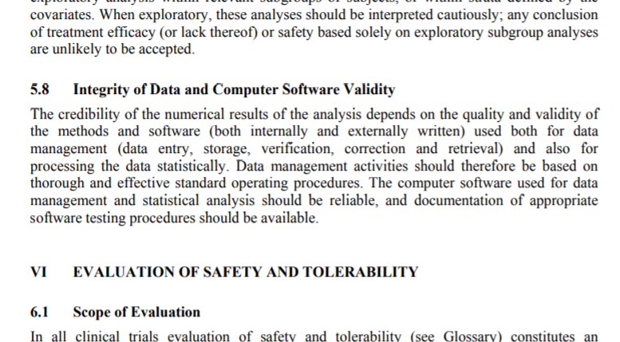
Reliable Software
5.8 Integrity of Data and Computer Software Validity
The credibility of the numerical results of the analysis depends on the quality and validity of the methods and software (both internally and externally written) used both for data management (data entry, storage, verification, correction and retrieval) and also for processing the data statistically. Data management activities should therefore be based on thorough and effective standard operating procedures. The computer software used for data management and statistical analysis should be reliable, and documentation of appropriate software testing procedures should be available.
ICH E9: https://www.ema.europa.eu/en/documents/scientific-guideline/ich-e-9-statistical-principles-clinical-trials-step-5_en.pdf

Slide 5
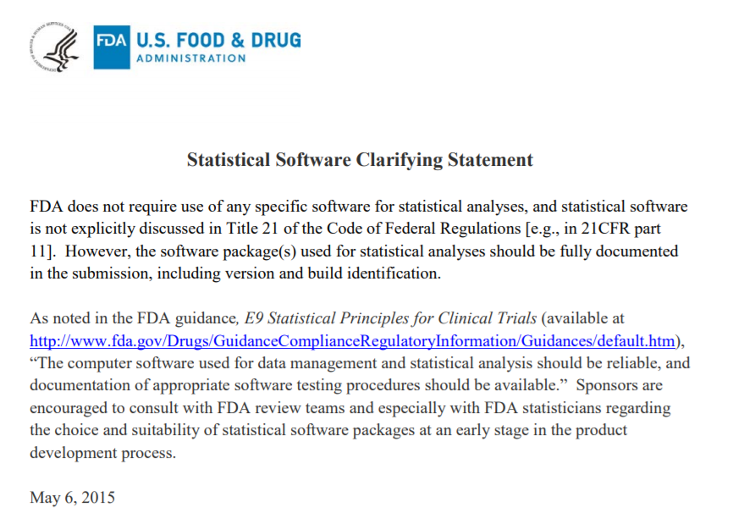
Source: https://www.fda.gov/downloads/ForIndustry/DataStandards/StudyDataStandards/UCM587506.pdf
Notes:
ICH: “… **should be reliable**, and documentation of **appropriate software testing procedures** should be available”
‘Validation’ isn’t actually mentioned.
Themes including ‘documentation’, ‘testing’ are emphasised.
Source: https://www.fda.gov/downloads/ForIndustry/DataStandards/StudyDataStandards/UCM587506.pdf

Slide 6
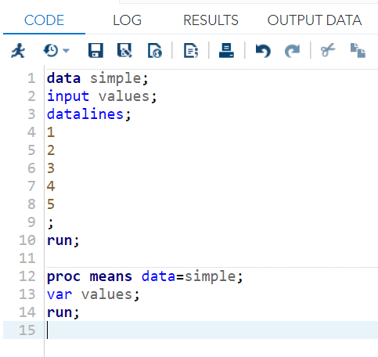
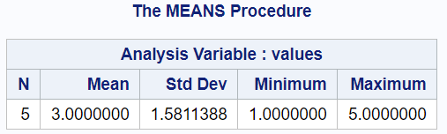
Example
A popular closed source language
Is this reliable?

Slide 7
Reliable Software
Why do we trust the summary?
“I know the actual answer”
“It’s in the ballpark of what I might expect to see”
“I’ve used the software before and it did what I expected”
“Many others use the software and it does what they expect”
“When I learnt statistics, I was taught using the software”
“The software is used/cited in statistical literature”
“I trust that the software owner develops it using best practice”
“The software owner provides tests that I can use to verify that it is working”
Intuition
Community Exposure
Developer SDLC
Notes:
Intuition only gets us so far. Difficult to explain to an auditor.
Community Exposure and SDLC are measurable.

Slide 8
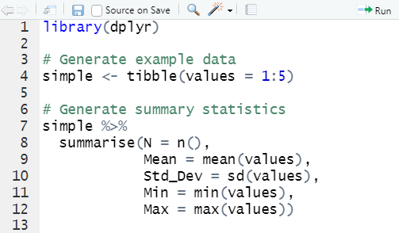
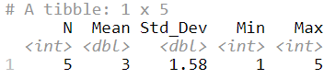
Example 2
R + Tidyverse
Is this reliable?

Slide 9
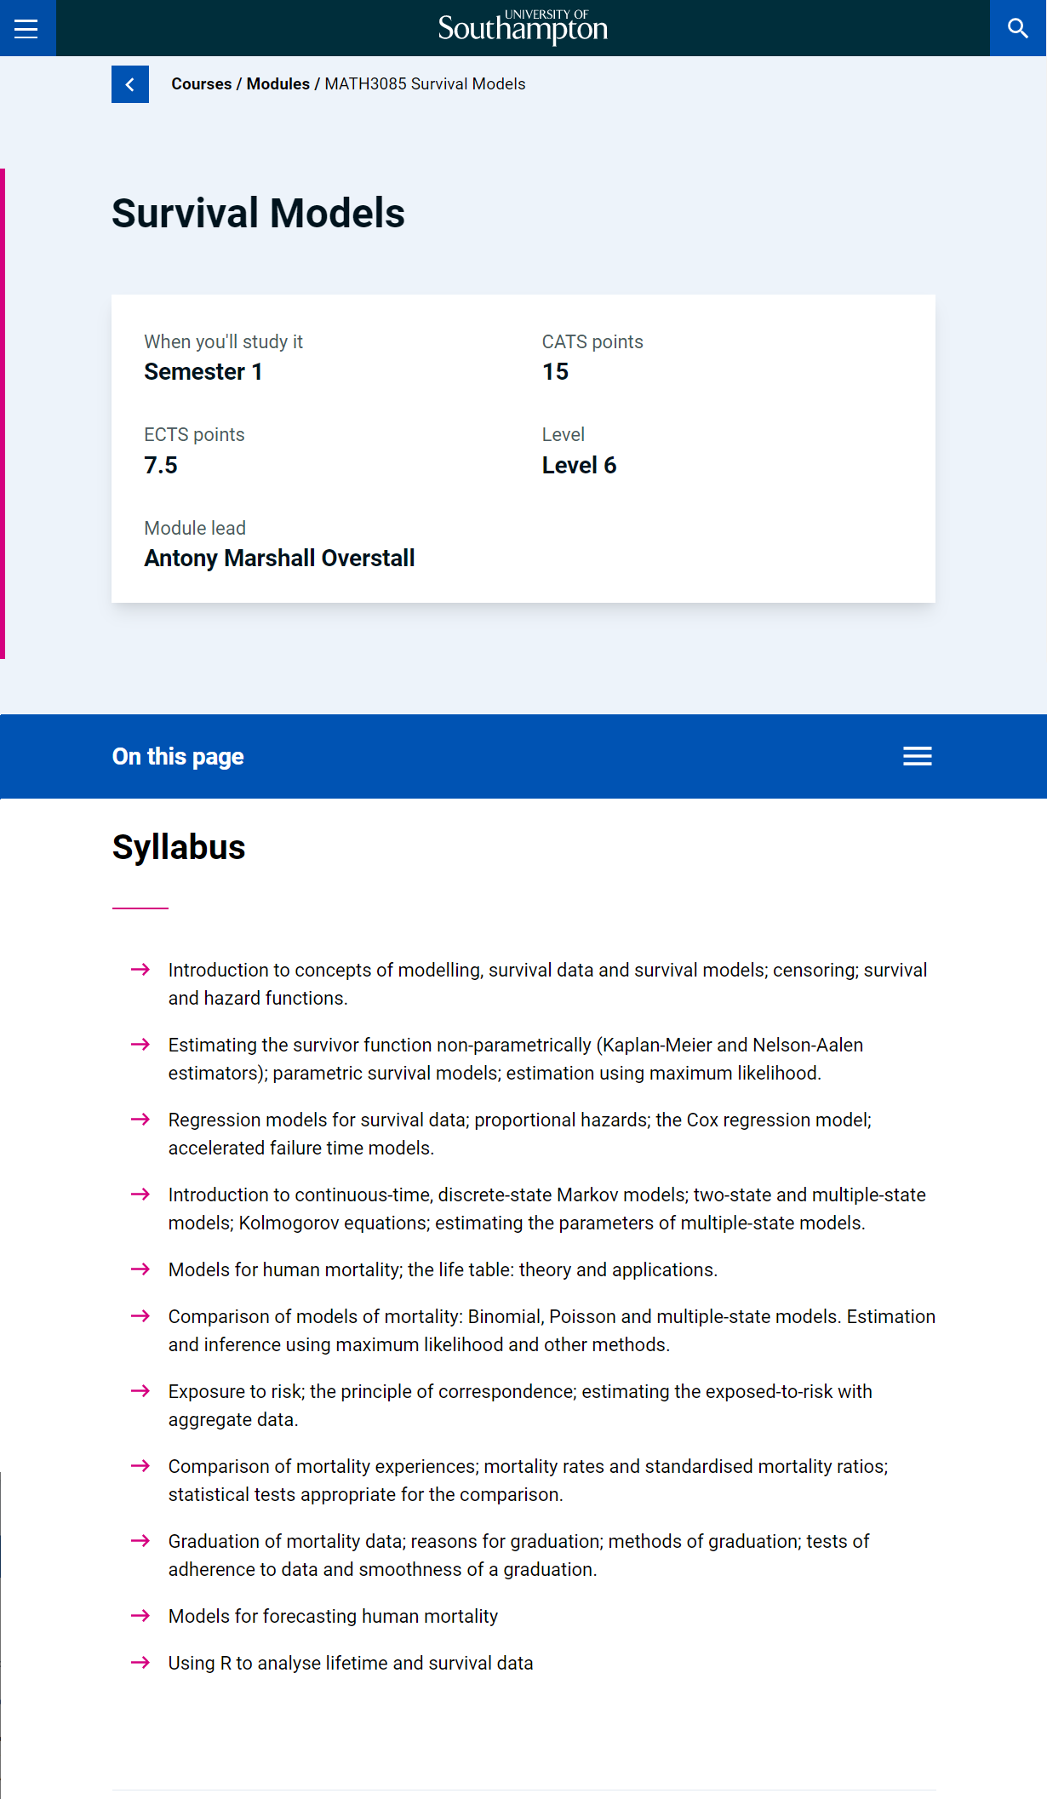

Slide 10

The Software is Cited in Statistical Literature

Slide 11

Reliable Software
Why do we trust the summary?
“I know the actual answer”
“It’s in the ballpark of what I might expect to see”
“I’ve used the software before and it did what I expected”
“Many others use the software and it does what they expect”
“When I learnt statistics, I was taught using the software”
“The software is used/cited in statistical literature”
“I trust that the software owner develops it using best practice”
“The software owner provides tests that I can use to verify that it is working”
Intuition
Community Exposure
Developer SDLC
Notes:
Intuition only gets us so far. Difficult to explain to an auditor.
Community Exposure and SDLC are measurable.

Slide 12
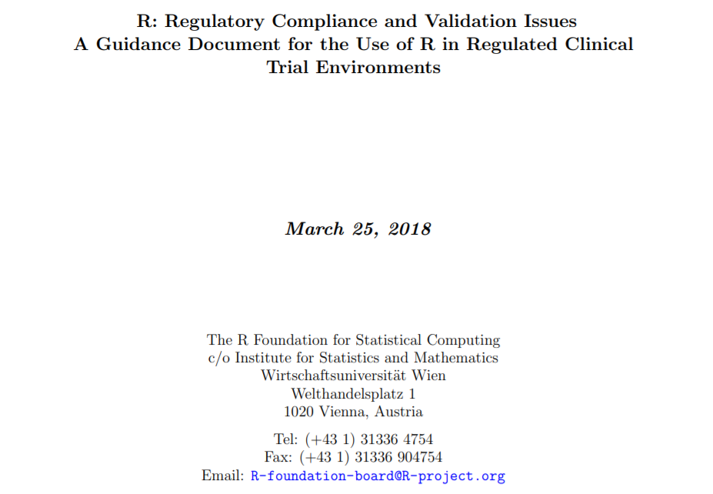
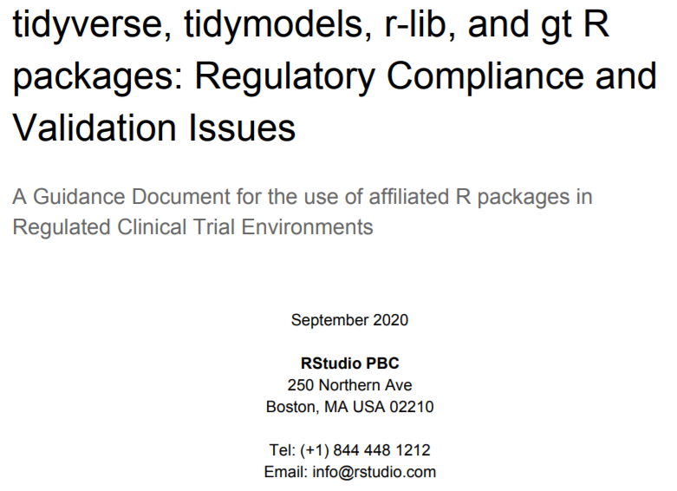
I trust that the software owner develops it using best practice
https://www.r-project.org/doc/R-FDA.pdf
https://resources.rstudio.com/assets/img/validation-tidy.pdf
See also: https://resources.rstudio.com/assets/img/validation-shiny-rmd.pdf

Slide 13
Reliable Software
Why do we trust the summary?
“I know the actual answer”
“It’s in the ballpark of what I might expect to see”
“I’ve used the software before and it did what I expected”
“When I learnt statistics, I was taught using the software”
“Many others use the software and it does what they expect”
“The software is used/cited in statistical literature”
“I trust that the software owner develops it using best practice”
“The software owner provides tests that I can use to verify that it is working”
Intuition
Community Exposure
Developer SDLC
Notes:
Intuition only gets us so far. Difficult to explain to an auditor.
Community Exposure and SDLC are measurable.

Slide 14
So what’s the problem?

Slide 15
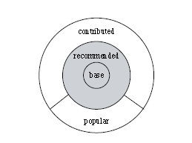
Challenge 1: The R Ecosystem
Core R (Base+Recommended) - Low risk
Contributed - Variable risk
Many different authors
Varying SDLCs
Varying levels of popularity
Potentially lots of unknowns
Image source: German, D.M. & Adams, Bram & Hassan, Ahmed E.. (2013). The Evolution of the R Software Ecosystem. Proceedings of the Euromicro Conference on Software Maintenance and Reengineering, CSMR. 243-252. 10.1109/CSMR.2013.33.

Slide 16
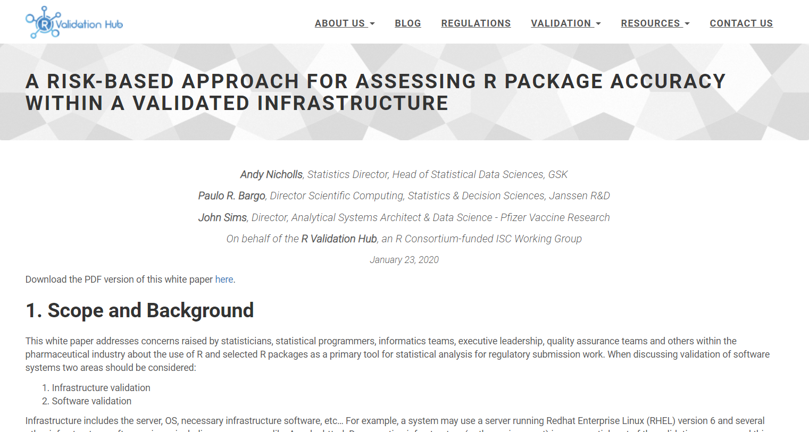

Slide 17
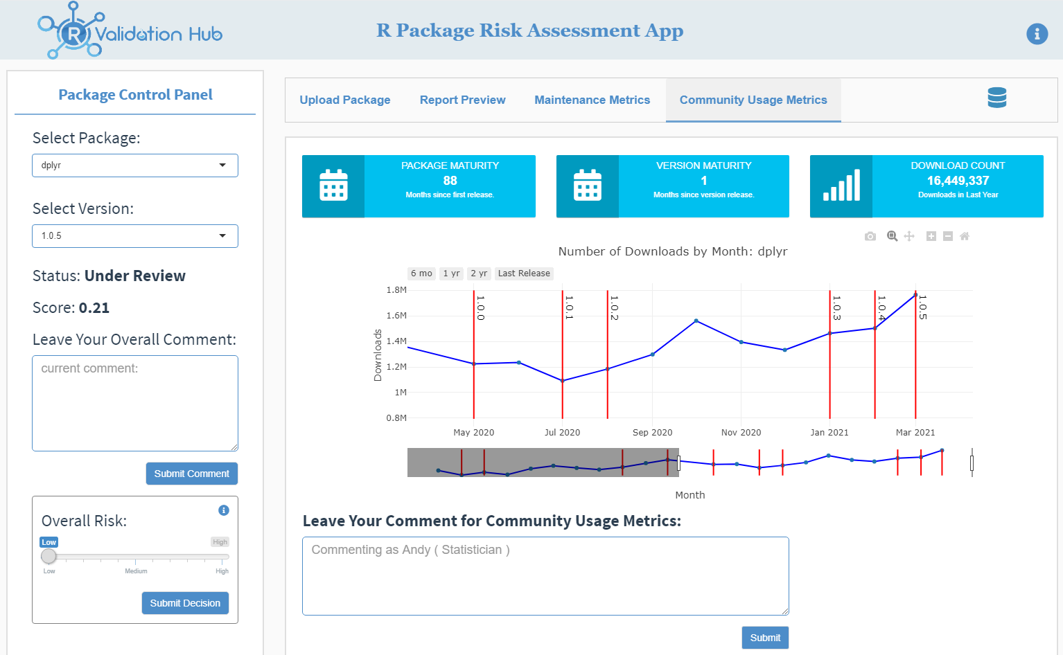

Slide 18

Challenge 2: Responding to Risk
ICH: “Appropriate software testing procedures”
Notes:
Image: https://www.denverpost.com/2019/06/08/dodgeball-tool-of-oppression-dehumanizing/
We can’t avoid risk completely. We must do our best to mitigate it.
Focus effort on the biggest risk areas.

Slide 19
Summary
Definitely possible
“The computer software used for data management and statistical analysis should be reliable, and documentation of appropriate software testing procedures should be available”
ICH E9
More of a challenge!
Thank You

Slide 20
Acknowledgements
R Validation Hub
The PSI AIMS SIG
Shutterstock

Slide 21
Further Reading
R
R Validation Hub
R: Regulatory Compliance and Validation Issues A Guidance Document for the Use of R in Regulated Clinical Trial Environments
tidyverse, tidymodels, r-lib, and gt R packages: Regulatory Compliance and Validation Issues
ICH
E9
FDA
FDA Statistical Software Clarifying Statement
21 CFR Part 11
Guidance for Industry Part 11, Electronic Records; Electronic Signatures — Scope and Application
Glossary of Computer System Software Development Terminology
General Principles of Software Validation; Final Guidance for Industry and FDA Staff
EMA
Notice to sponsors on validation and qualification of computerised systems used in clinical trials
Q&A: Good clinical practice (GCP)

